Slide 1

Introduction
Name: Anirudha Mohite
Educational Background:
Pursuing an MBA from Oriental Institute of Management
Current Role:
Web Development Intern at Unified Mentor

Slide 2
Projects:
Cricket Quiz
Music Player
Calculator

Slide 3

Cricket Quiz
Project Overview:
This interactive quiz application tests users' knowledge on the T20 World Cup 2024. It features a user-friendly interface with a start button, a timer for each question, and a scoring system. Built with HTML, CSS, and JavaScript, the quiz provides real-time feedback on answers and displays the final score.

Slide 4

Problem Statement
The primary goal of this project is to create an engaging and educational quiz application that can effectively evaluate the user's knowledge about the T20 World Cup 2024. Key challenges addressed include:
Interactive Quiz Experience: Ensuring that the quiz is interactive and engaging, with a clear user interface that guides users through the quiz.
Real-Time Feedback: Providing immediate feedback on user answers, including correct and incorrect answers, and showing a score at the end of the quiz.
Timer Functionality: Implementing a timer for each question to add a level of challenge and ensure users answer within a set time limit.

Slide 5

Tools and Techniques Used
HTML: Structuring content—start button, questions, options, timer, results.
CSS: Styling—layout, colors, button styles, animations. Responsive design for various screen sizes.
JavaScript:
1.Event Handling: Managing user interactions.
2.Timer Implementation: Real-time question timers.
3.Dynamic Content: Loading and updating quiz content.
4.Feedback Mechanism: Immediate answer feedback.
External Libraries:
1.Font Awesome: Icons for enhanced visual appeal.

Slide 6
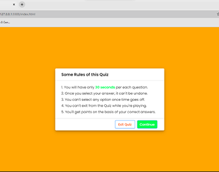

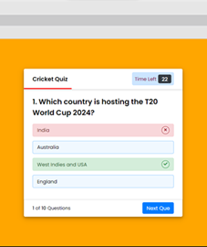
Snapshot

Slide 7
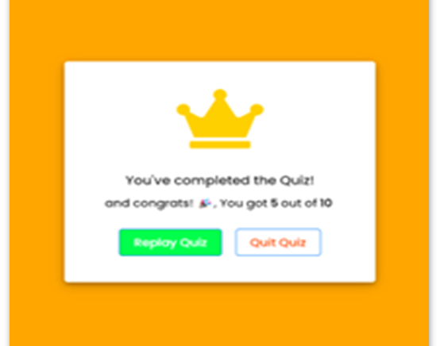
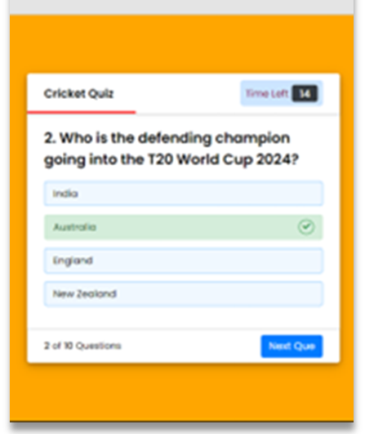
snapshot

Slide 8

Music Player
Project Overview:
Developed a modern music player using HTML, CSS, and JavaScript.
Key functionalities include play, pause, next, previous, volume control, and dynamic song loading.

Slide 9

Problem Statement
The goal of this project is to develop a modern music player that provides users with a seamless and interactive listening experience. Key challenges include:
1.User Interface: Designing an intuitive and visually appealing interface for easy navigation and control.
2.Functionality: Implementing features such as play/pause, volume control, and track navigation.
3.Performance: Optimizing the player for smooth playback and minimal latency.

Slide 10

Techniques and Tools Used
HTML: Structured the player interface and dynamic content display.
CSS: Styled the layout, animations, and responsiveness.
JavaScript: Implemented interactive features, audio control, and dynamic UI updates.
External Resources: Utilized Google Fonts and Material Icons for enhanced design and functionality.

Slide 11
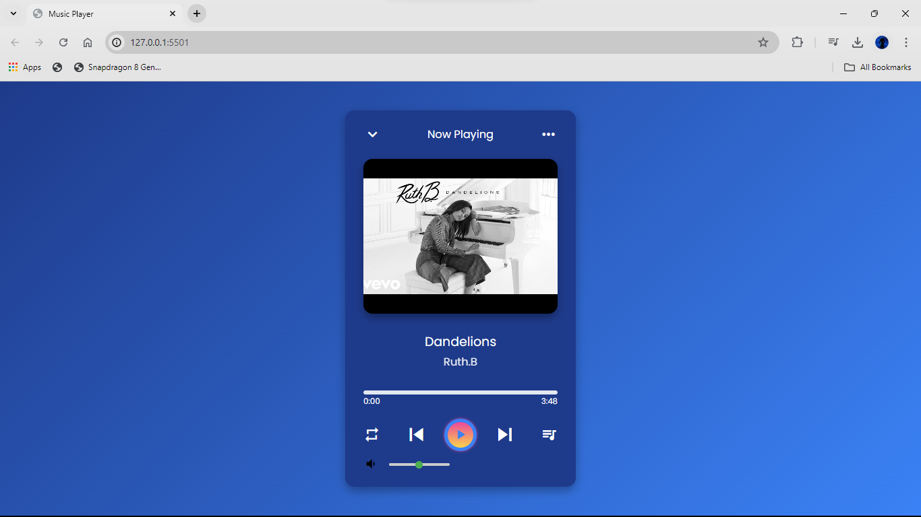
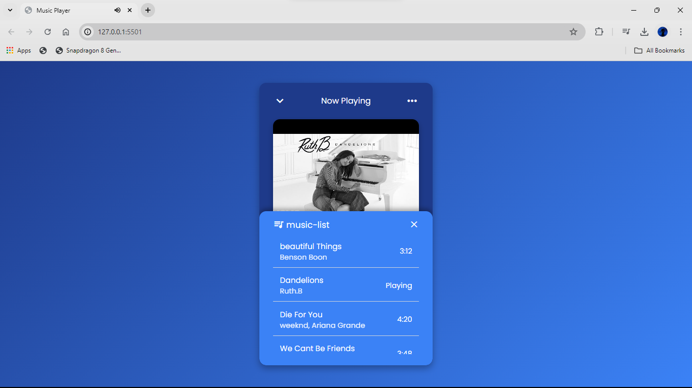
Snapshot

Slide 12

Calculator
Project overview:
This project involves creating a basic web-based calculator.
The calculator performs essential arithmetic operations such as addition, subtraction, multiplication, and division.
The goal is to provide a user-friendly interface resembling a traditional handheld calculator.

Slide 13
Problem Statement
Need for a simple, web-based calculator mimicking a traditional handheld calculator.
Support for keyboard input and backspace functionality.

Slide 14

Techniques and Tools Used
HTML: Structure of the calculator.
CSS: Styling for traditional calculator appearance.
JavaScript: Interactivity and functionality.
Event Listeners: Handle button clicks and keyboard input.

Slide 15
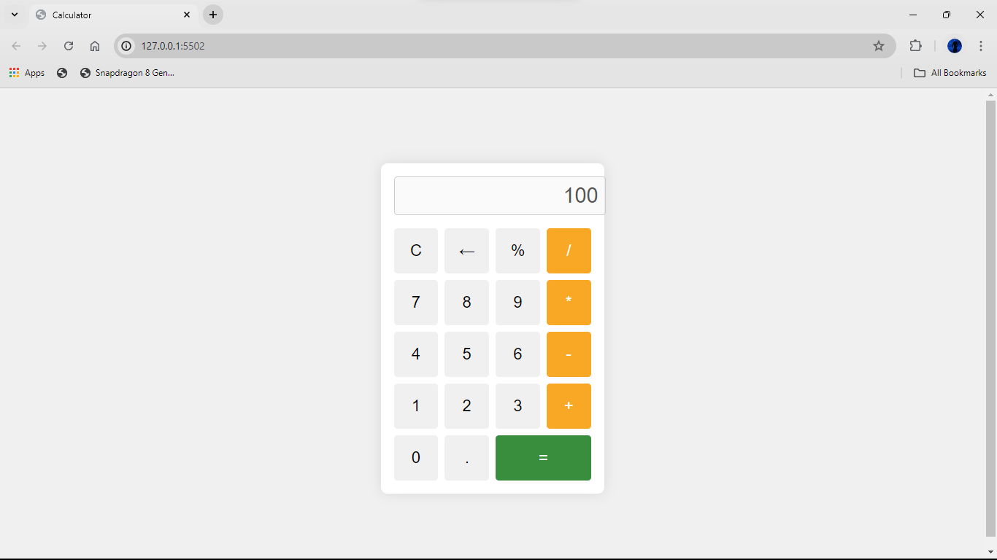
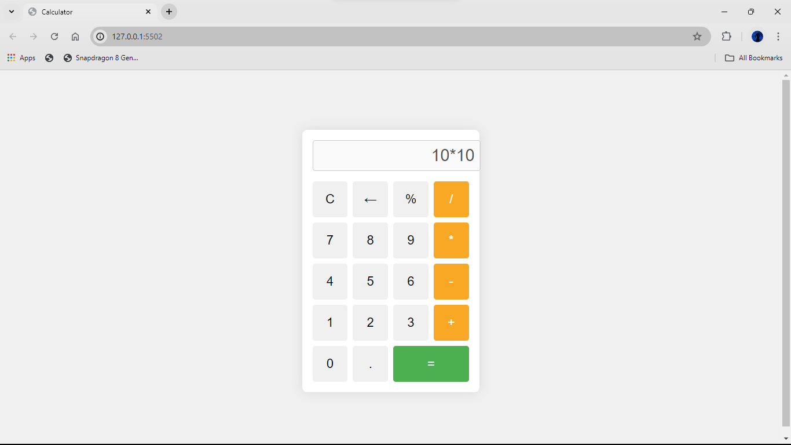
Snapshot

